Slide 1
End - Semester Report (CSE 343)
Title: Stock Market Prediction using Sentimental Analysis
Aaryendra Chhabra 2020005
Aayush Gakhar 2020006
Jayan Pahuja 2020071
Sanyam Goyal 2020116

Slide 2
Abstract: Motivation behind the topic
Stock price movement and volatility prediction aim to predict stocks’ future trends to help investors make sound investment decisions and model financial risk. Stock movement prediction is a difficult problem because the market is highly stochastic and we make time-dependent predictions based on chaotic data.
Over the last 20 years, we have seen a positive shift in the financial market. Every single day, we see more and more people getting involved in the financial sector with the hope of getting quick profit gains through predictive trading. But, if there is a possibility of profit, there also lies an equal possibility of loss.

Slide 3
Abstract: Motivation behind the topic
But, if there is a possibility of profit, there also lies an equal possibility of loss. People don’t understand that the financial sector is one of the most dynamic sectors of all and going into this with a blind sight can be highly hazardous for the individuals.
Modern machine learning models are highly desirable in such dynamic sectors for accurate stock predictions, so that it becomes easier for people to understand how the stock market works and maximize their own profits. This idea has the potential to revolutionize the stock market, that makes us even more dedicated towards this idea. We have tried different machine learning models available to us in order to analyze the accuracy for the prediction of the values of different stocks at the NYSE.

Slide 4
Introduction: An Insight into the Topic
Both investors and scholars have long been interested in stock movement prediction (Frankel, 1995; Edwards et al., 2007; Bollen et al., 2011; Hu et al., 2018). More than five trillion worth of stocks are traded every day. In behavioral finance studies, stock movements are attributed to investors’ cognitive and emotional biases. On the other hand, new information related to markets will change investors’ expectations about the markets and cause stock prices to move.
Scholars have found that stock movements are affected by various sources, including transaction data, news, social media, and search behavior. Public news and social media are two key content resources for stock market forecasting in natural language processing (NLP), and the models that employ these sources are frequently discriminative.

Slide 5
Introduction: An Insight into the Topic
The two major types of stock market analytical techniques are technical analysis and fundamental analysis. Using historical data, particularly price and volume, technical analysis makes stock price predictions. It is important to keep in mind that employing technical analysis to make money would be more difficult the more efficient the market is. Fundamental analysis, on the other hand, produces predictions based on the intrinsic worth of the investment by evaluating macroeconomic factors, industry features, and company features, such as financial reports, competitors, and viability.
The traditional strategy is to concatenate these into a compound vector and utilize various learning models, including support vector machines (SVMs), decision trees (DTs), and artificial neural networks (ANNs), to make predictions. Deep neural networks are extensively used, and event driven approaches using structured event representations have already been studied in this domain (Le and Mikolov, 2014). To overcome this challenge, some scholars have modeled multidimensional information with tensors to achieve better performance.

Slide 6
Literature Review: Paper - 1
Title: A Multimodal Event Driven LSTM Model for Stock Prediction using Online News
Authors: Qing Li, Jinghua Tan, Jun Wang, Hsinchun Chen
This paper presents a multimodal event-driven LSTM model for stock prediction using online news. The authors argue that the price of stock is always driven by unemotional investors, and that stock movements are attributed to investors' cognitive and emotional biases. They further argue that the volatility of the stock market stems from the release, dissemination and absorption of information, and that the stock market is affected by information sources such as fundamental and financial news.
The authors propose a vector-based model that converts the vector into a two-dimensional tensor, P+, P- and Dt for media data. The model uses a finance-related dictionary to capture sentiments. It illustrates the use of a second order tensor, R(i1xi2), i1 is the fundamental data, and i2 is the media data.

Slide 7
Literature Review: Paper-1
The algorithm used is the event-driven LSTM Model, which is designed to address heterogeneity by controlling memory in the neural network. The authors then consider the indirect influence of related companies on media-aware stock movements.
The Tucker Decomposition and Lagrange Objective function are used to obtain the correlation factors from the 2D tensor. Iterative gradient descent is used to calculate the Lagrangian parameter. The stock relatedness is then constructed by building a media-based enterprise network, where each node represents a listed item, and each edge represents the news co-exposure. The weights are the number of news articles.
Trigger-based strategy is used in the LSTM Model to reinforce the information. DA (directional accuracy) and MCC (Matthews correlation coefficient) are used as evaluation metrics. The authors find that the LSTM model outperforms SVM, DT and BP in terms of accuracy and MCC.

Slide 8
Literature Review: Paper-2
Title: Stock Market Prediction Using Machine Learning
Authors: V Kranthi Sai Reddy
Stock market prediction is a process of trying to determine the future value of a stock or other financial instrument traded on a financial exchange. Many people attempt to predict stock prices in order to make profits from trading.
There are two main approaches to stock market prediction: technical analysis and fundamental analysis. Technical analysis is a method of predicting stock prices by looking at past market data, such as price movements and trading volumes. Fundamental analysis is a method of predicting stock prices by looking at economic indicators, such as company performance, economic conditions, and political factors. There have been numerous attempts to predict stock prices with machine learning. Some of these attempts have been more successful than others.

Slide 9
Literature Review: Paper-2
In this paper, they have proposed a machine learning approach to stock market prediction. They have used a support vector machine (SVM) to predict stock prices for the large and small capitalizations and in the three different markets, employing prices with both daily and up-to-the-minute frequencies. The SVM algorithm draws a boundary over the data set called the hyper-plane, which separates the data into two classes.
They have also used Radial Basis Function (RBF) as another metric to predict the stock price. A radial basis function is the real-valued function whose value depends only on the distance from the origin. The RBF units provide a new basis set for synthesizing the output function. The radial basis functions are not orthogonal and are overcomplete.
Feature selection using features such as Stock and Index Momentum also play a pivotal role in the prediction using SVM. The results show that the SVM is able to predict stock prices with a high degree of accuracy. They find that the SVM performs better than other machine learning methods, such as artificial neural networks and decision trees.

Slide 10
Dataset Features ( For Window size = 5 )
Open1, Close1, Low1, High1, Volume1, Pos1, Neut1, Neg1 (N-5) Day | Open2, Close2, Low2, High2, Volume2, Pos2, Neut2, Neg2 (N-4) Day | … | … | Open5, Close5, Low5, High5, Volume5, Pos5, Neut5, Neg5 (N-1) Day | Low (N) | High (N) | Close (N)
 |  |  |  |  | Dependent Features (Target Variable)
Independent Features
Rows : Number of working days in year 2014-2015
Columns : ( Window Size x 8 ) + 3

Slide 11
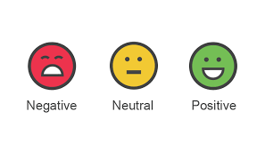

Sentiment Analysis of Tweets
1. Performed pre-processing on the tweets to remove urls, hashtags, punctuations and stopwords.
2. Used VADER ( Valence Aware Dictionary and sEntiment Reasoner ) Sentiment analysis on the preprocessed tweets to label them as Positive, Neutral or Negative.
VADER is a lexicon and rule-based tool which performs well mainly on social media data. It returns a Compound score scaled between -1 as the most extreme negative score and +1 as the most extreme positive score.
3. Finally we get the count of positive, neutral and negative sentiment oriented tweets for each date for all the stocks.
4. In case of no tweets for a particular date we assume there were no significant tweets made mentioning about that company.

Slide 12
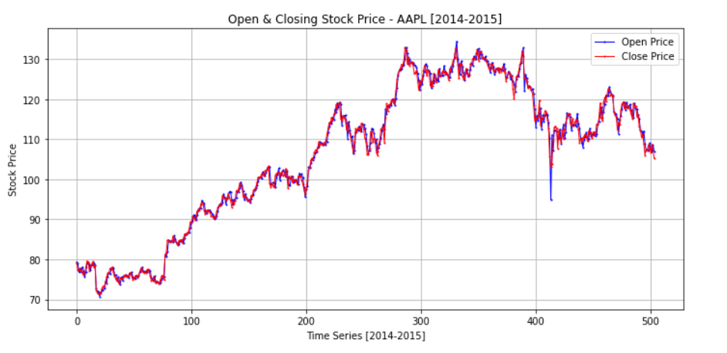
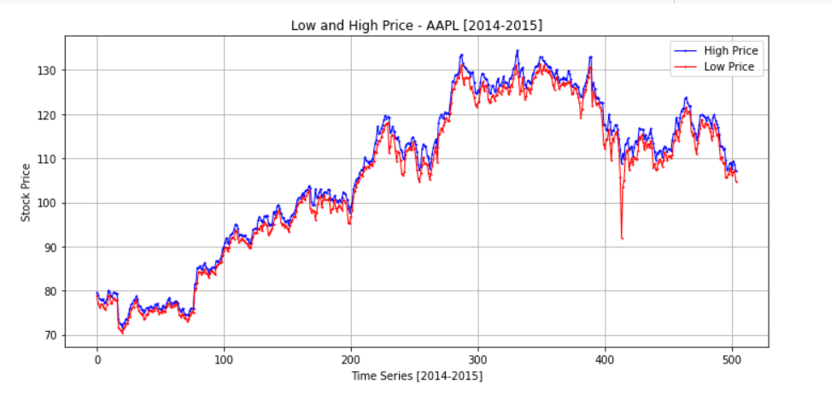
EDA (Exploratory Data Analysis)
The stock price of AAPL has varied a lot in the given 2 years of time period ( 2014-2015 ) with an overall growth and profit.
Minimum recorded stock price : 70.507141
Maximum recorded stock price : 134.539993
Average Closing Stock Price : 106.152327
Standard deviation : 17.661503

Slide 13
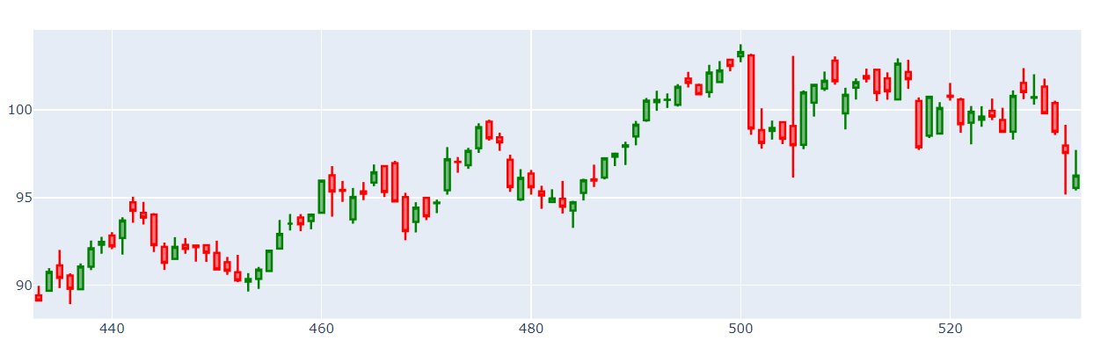
Candlestick Chart

Slide 14
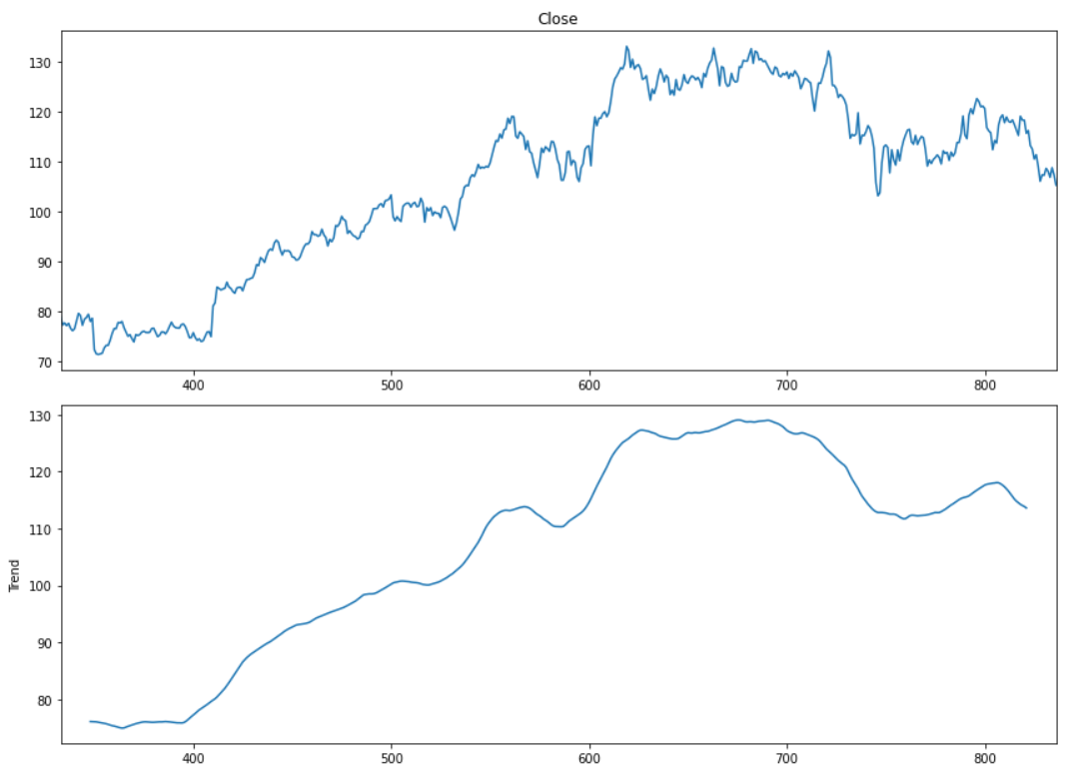
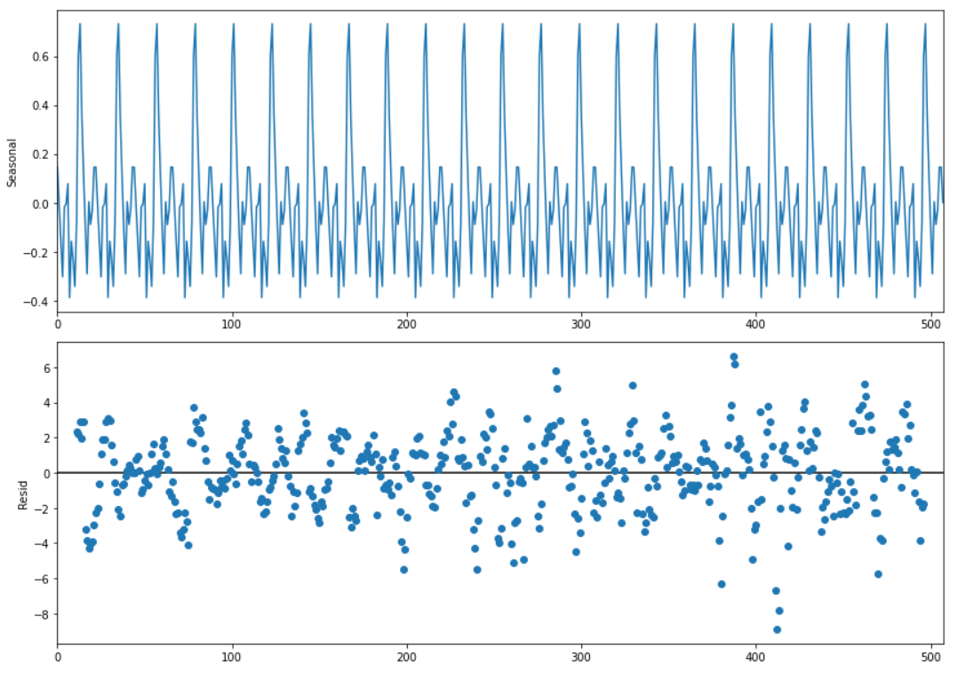
Visualizing Pattern (Monthly) in movement of stock prices
We first estimate the trend by applying a convolution filter to the data.
Then the trend is subtracted from the actual stock price series and the average of this detrended series for each given period (Monthly in our case) is our seasonal trend of our stock prices. Residual is what's left over after trends and seasonality are removed.
Overall gain in each season is clearly evident which justifies the overall growth of stock.

Slide 15
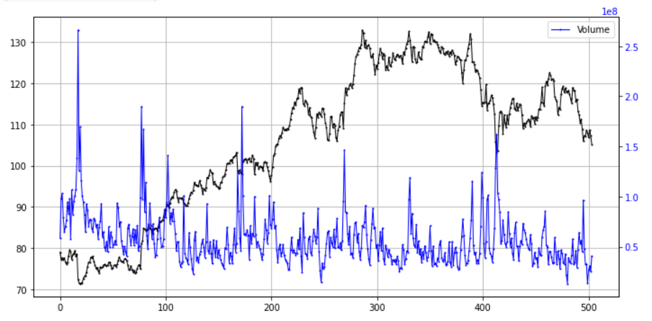
Volume v/s Stock price
Volume of stock has decreased ( Nearly half ) in the past two years with a lot of deviation daywise.
Though there seems to be no in general correlation between the closing price and volume on daily basis.
Note : Scale of y-axis on graph

Slide 16
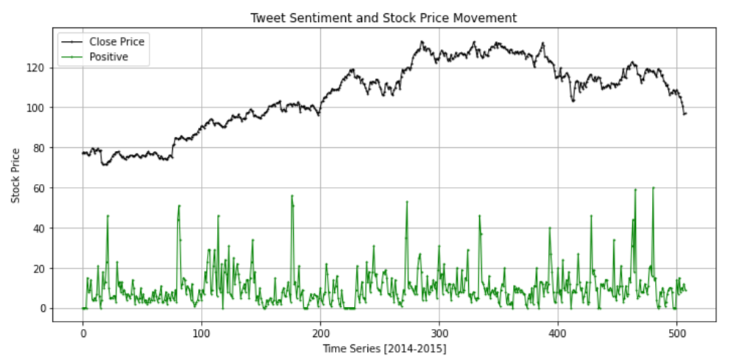
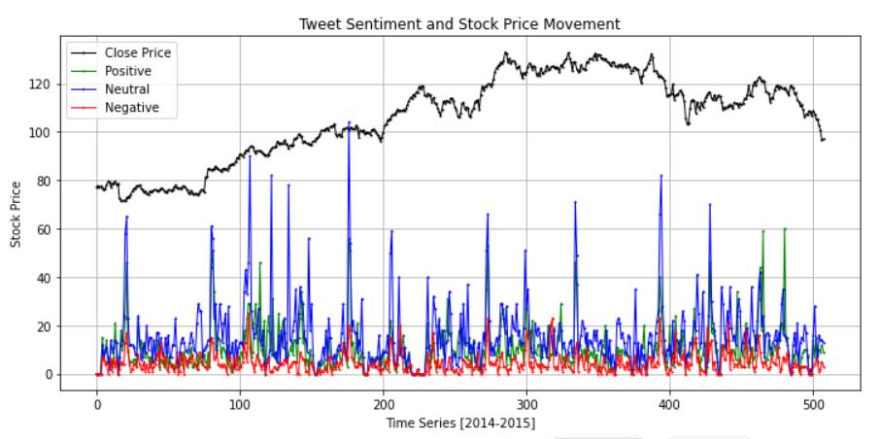
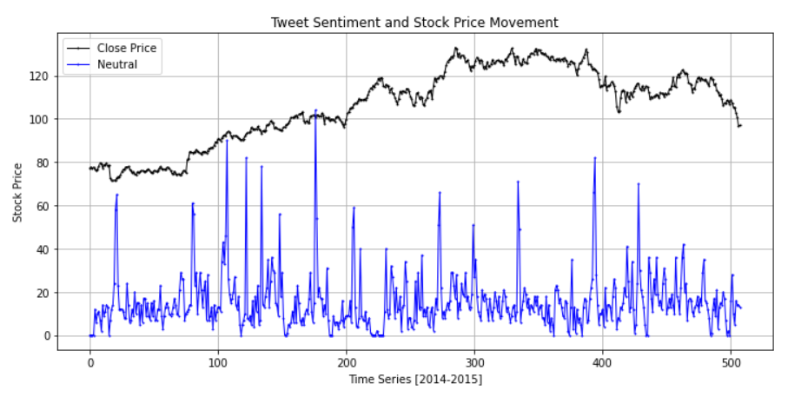
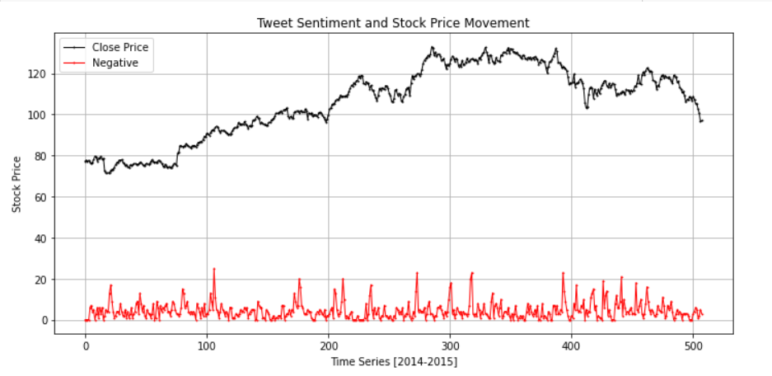
Tweet Sentiment v/s Stock Price

Slide 17
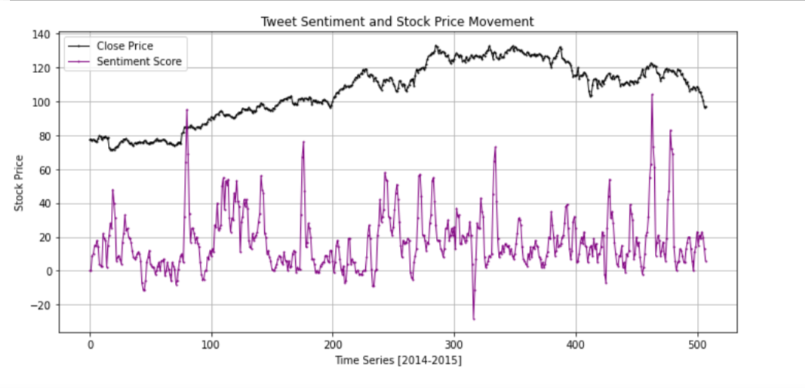
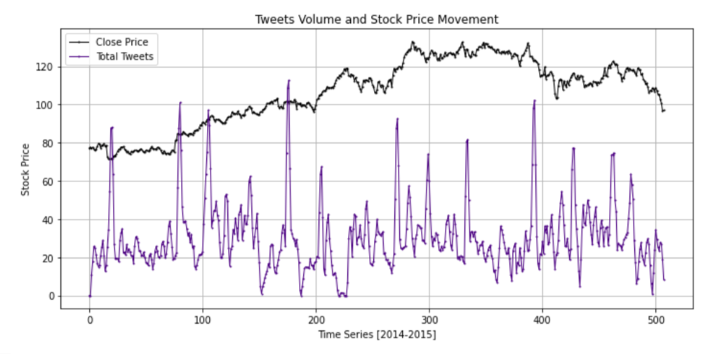
Tweet Sentiment v/s Stock Price
Observed sentiment score peaks and dips followed by a stock price hike and fall respectively and vice versa hinting towards bidirectional impact among these two features.

Slide 18
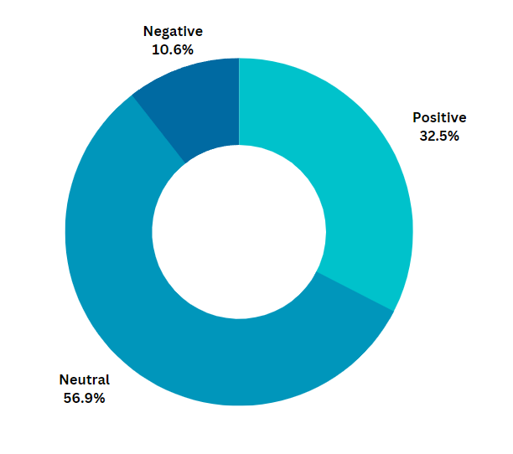
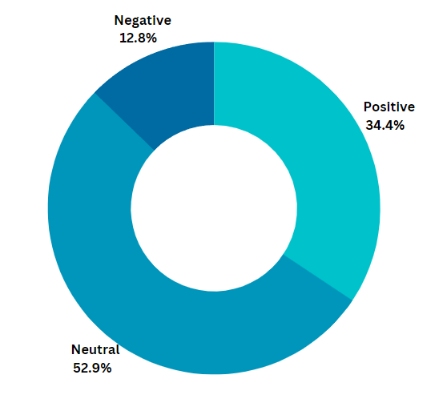
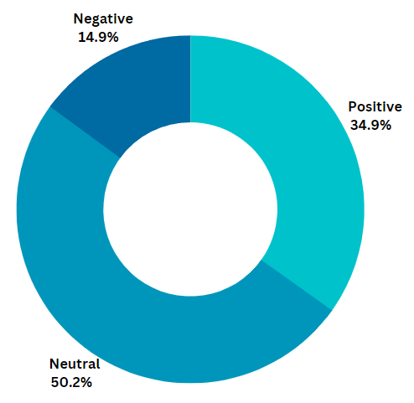
Tweet Sentiment Distribution
Apple (AAPL)
Google (GOOG)
Microsoft (MSFT)

Slide 19
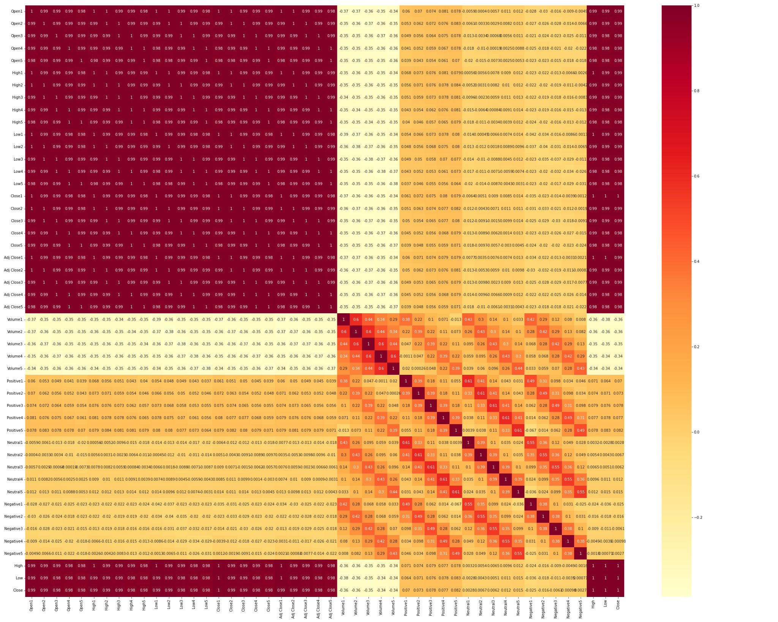
Heatmap for features correlation
Close, Low and High stock prices (Dependent Features) of the day are highly correlated with stock movement (Open, Low, High, Close) and patterns of past days.
We can also observe a little correlation between the sentiment of tweets in the previous days and stock price.

Slide 20
Methodology
We compared linear regression, decision tree, random forest and gradient boost for our models. As the stock price prediction depends on the prices of previous days, we gave the previous days stock prices as input.
We varied the number of days and found the best outcome with least rmse at n=3.
We used squared error method and ’best’ strategy as splitter for decision tree. We used squared error method for random forest.

Slide 21
Result/Analysis
We ran the model for different window sizes and had obtained the data as follows:
Value of n (Parameter) | Models used and RMSE Values
5 | Linear Regression : 2.257573809716335 Random Forest : 2.3757716304022227 Decision Trees : 2.9405511469871444 Gradient Boost : 2.524182572412116
3 | Linear Regression : 2.175462447355757 Random Forest : 2.4303288393792077 Decision Trees : 3.2952034029887134 Gradient Boost : 2.4406243600838198
1 | Linear Regression : 2.2451821378013275 Random Forest : 2.305894043502469 Decision Trees : 3.2202118558074315 Gradient Boost : 2.323831009717305
From the above data, we find the optimal value of n = 3

Slide 22
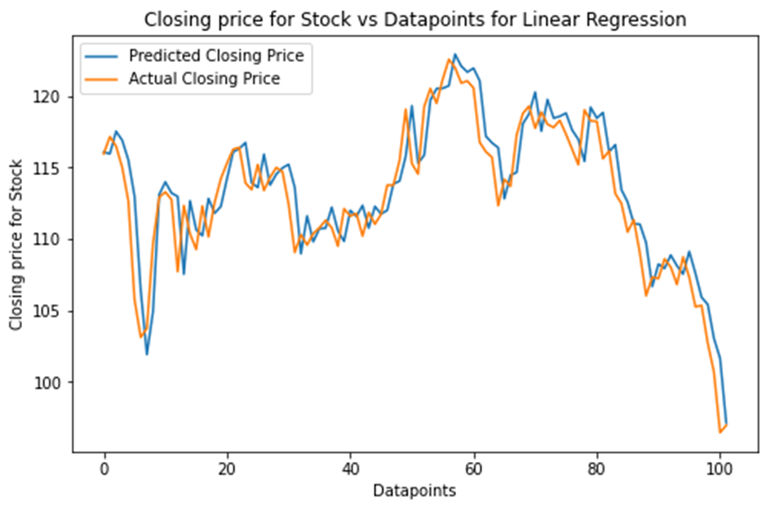
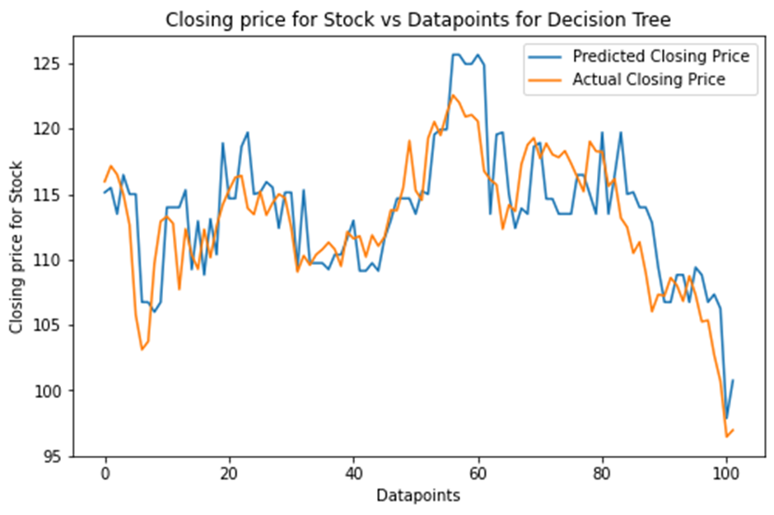
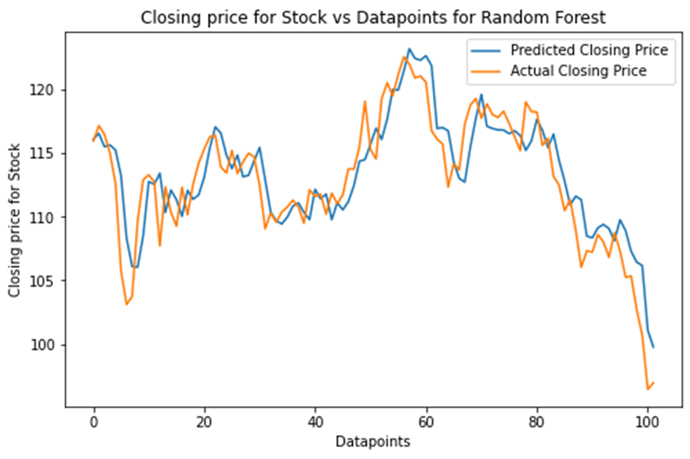

Results/Analysis

Slide 23
Results/Analysis
We performed Linear Regression, Decision Tree, Random Forest and Gradient Boost on the Stock Market Dataset.
RMSE for Linear Regression came out to be: 2.175462447355757
RMSE for Decision Tree came out to be: 3.2952034029887134
RMSE for Random Forest came out to be: 2.4303288393792077
RMSE for Gradient Boost came out to be: 2.4406243600838198
Conclusion: Linear Regression performs the best on our dataset.

Slide 24
Conclusion
Stock markets are strongly affected by various types of highly interrelated information. In both traditional finance and behavioral finance, it is believed that market information, especially fundamental information and news report information, shapes stock movements.
We have covered following work so far:
Data Collection, Pre-Processing and Data Visualization, Feature Extraction and Sentimental Analysis, Feature Engineering, Selection, Heatmaps, Linear Regression, Decision Trees and Random Forest.
After implementing these given models, we had checked for the RMSE values and had compared the actual and predicted values for the same.

Slide 25
Timeline
Week 1 & 2: Data Collection
Week 3: Pre-Processing and Data Visualization
Week 4: Feature Extraction and Sentimental Analysis
Week 5: Feature Engineering, Selection, Heatmaps
Week 6: Linear Regression
Week 7: Decision Trees and Random Forest
We have covered this work so far. We have learnt about decision trees and random forest before SVM, hence we had to interchange the weekly deadlines. Further work will include learning about LSTMs, CNN based models, ANN and RNN based models and look out for the best predictor available.

Slide 26
Team Member’s Contribution
Data Collection -> Aayush and Jayan
Data Cleaning -> Aayush
Data Preprocessing -> Sanyam and Aaryendra
Data Visualization -> Sanyam
Feature Extraction -> Aayush and Sanyam
Feature Analysis -> Jayan and Sanyam
Linear Regression -> Aaryendra and Aayush
Decision Trees, Random Forest -> Aaryendra and Jayan
Gradient Boosting, Check for Overfitting -> Aaryendra and Sanyam
Report Writing -> Aayush and Jayan
Final Outcome -> Aaryendra and Jayan

Slide 27
Work done after Mid-Sem Report
-> Support Vector Machines (SVMs)
-> Multi-Layer Perceptron (Regressor)
-> Hyperparameter Tuning
-> Comparison of different models used
-> Report Completion

Slide 28
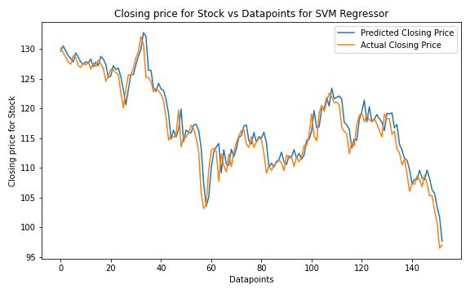
Support Vector Machines (SVMs)

Slide 29
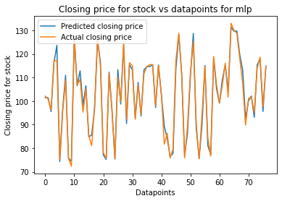
Multi-Layer Perceptron (Regressor)

Slide 30
Hyperparameter Tuning
In this case, we used different hyperparameters for each of the regressors that were available to us, and found the best parameters for each of these models using GridSearch.
Model Name | Best Hyperparameters | Best Estimators
Gradient Boost | {'criterion': 'mae', 'learning_rate': 0.25, 'loss': 'lad', 'max_features': 'sqrt'} | criterion='mae', learning_rate=0.25, loss='lad', max_features='sqrt'
LR with Ridge Regularization | 'alpha': 1e-05, 'fit_intercept': True, 'normalize': True, 'solver': 'lsqr' | alpha=1e-05, normalize=True, solver='lsqr'
LR with Lasso Regularization | {'alpha': 0.001, 'fit_intercept': True, 'normalize': True} | alpha=0.001, normalize=True

Slide 31
Hyperparameter Tuning
In this case, we used different hyperparameters for each of the regressors that were available to us, and found the best parameters for each of these models using GridSearch.
Model Name | Best Hyperparameters | Best Estimators
Linear Regression | {'fit_intercept': True, 'normalize': True} | normalize=True
Decision Trees | 'criterion': 'mae', 'max_depth': 7, 'max_features': 'auto' | criterion='mae', max_depth=7, max_features='auto'
Random Forest | 'criterion': 'mae', 'max_depth': 11, 'max_features': 'auto', 'n_estimators': 10 | criterion='mae', max_depth=11, n_estimators=10

Slide 32
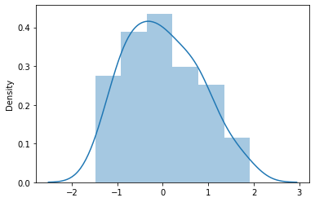
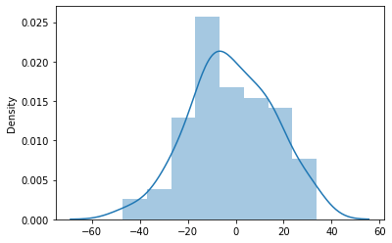
Analysis of Distribution Plots
We obtain the following distplot from the given dataset, when we plot the difference in the predicted and the actual values for our dataset.
Gradient Boost Plot K-Neighbours Plot

Slide 33
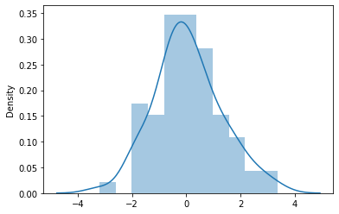
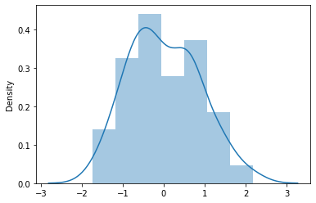
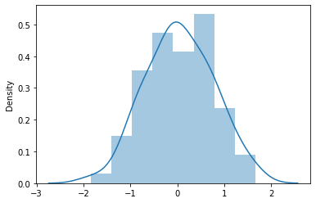
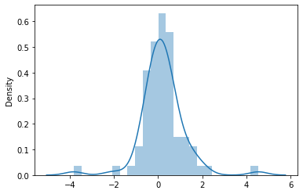
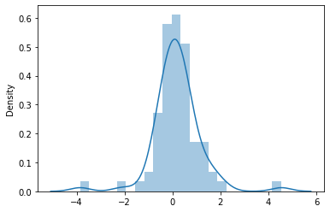
Analysis of Distribution Plots
Decision Trees Random Forest LR with Lasso
LR with Ridge Linear Regression

Slide 34
Model Comparison
In this part, we had compared the different regression models available to us, and had computed the different parameters associated with each model.
Model Name | Variance | Mean Absolute Error (MAE) | Mean Squared Error (MSE) | Root Mean Squared Error (RMSE) | R2 Score
K Neighbours | 0.24071806975507437 | 13.518715825974025 | 257.0723940459628 | 16.03347729115437 | 0.1765010861639985
Gradient Boost | 0.9968432304284717 | 0.8003277974228887 | 0.9981447824343413 | 0.9990719605885962 | 0.9968025693803638
Random Forest | 0.9970700861211267 | 0.7629564359740075 | 0.9322274130769644 | 0.9655192453167178 | 0.9970137273394678
Decision Trees | 0.9947518122410777 | 1.0311685974025964 | 1.6535900852347762 | 1.2859199373346601 | 0.9947029332178027

Slide 35
Model Comparison
Model Name | Variance | Mean Absolute Error (MAE) | Mean Squared Error (MSE) | Root Mean Squared Error (RMSE) | R2 Score
MLP Regressor | 0.9878790771643409 | 1.394883584420612 | 3.808663049545984 | 1.9515796293121077 | 0.9876512020901861
Linear Regression | 0.9984105607752541 | 0.4998970927402394 | 0.4982608593794327 | 0.7058759518353297 | 0.9984038843298259
Lasso Regularization | 0.9981139970806651 | 0.5671942280837702 | 0.5997123020551185 | 0.7744109387496528 | 0.9980788974592574
Ridge Regularization | 0.9983753902604772 | 0.5032240151708921 | 0.5090402321901811 | 0.7134705545361919 | 0.9983693539718135
SVM Regressor | 0.9908394833394849 | 1.234495899034324 | 2.90889368932787 | 1.7055479147345 | 0.989864686786578

Slide 36
Results
R2 Score:
R-squared is a statistical measure of how close the data are to the fitted regression line. It is also known as the coefficient of determination, or the coefficient of multiple determination for multiple regression. In our model, we see the following order based on the R2 Score:
Linear Regression > LR with Ridge > LR with Lasso > Random Forest > Gradient Boost > Decision Trees > SVM Regressor > MLP Regressor > K Neighbours
We can conclude that linear regression performs the best on our dataset. However, this is not the only parameter to assess the better model. We also conclude that K-Neighbours performs the worst for our dataset.

Slide 37
Results
Mean Absolute Error (MAE):
R-squared is a statistical measure of how close the data are to the fitted regression line. It is also known as the coefficient of determination, or the coefficient of multiple determination for multiple regression. In our model, we see the following order based on the MAE values:
Linear Regression < LR with Ridge < LR with Lasso < Random Forest < Gradient Boost < Decision Trees < SVM Regressor < MLP Regressor < K Neighbours
We can conclude that linear regression performs the best on our dataset. However, this is not the only parameter to assess the better model. We also conclude that K-Neighbours performs the worst for our dataset.

Slide 38
Results
Root Mean Squared Error (RMSE):
Root mean square error or root mean square deviation is one of the most commonly used measures for evaluating the quality of predictions. It shows how far predictions fall from measured true values using Euclidean distance. In our models, we see the following order based on the RMSE Values:
Linear Regression < LR with Ridge < LR with Lasso < Random Forest < Gradient Boost < Decision Trees < SVM Regressor < MLP Regressor < K Neighbours
We can conclude that linear regression performs the best on our dataset. We also conclude that K-Neighbours performs the worst for our dataset.

Slide 39
Novelty in our Project
Sentiment analysis in stock market prediction is a relatively new concept, but one that is quickly gaining traction. By analyzing the sentiment of news articles and social media posts, investors have a better understanding of how different market events might influence stock prices. Sentiment analysis allows investors to evaluate the overall sentiment of a particular stock or the overall market and gain an understanding of how their investments might be influenced by current events. This type of analysis can provide investors with an edge in predicting future stock prices, enabling them to make more informed decisions and maximize their returns.

Slide 40
Team Member Contributions
Support Vector Machines - Sanyam
MLP Regressor - Aayush
Hyperparameter Tuning - Aaryendra, Aayush and Jayan
Model Comparison - Aaryendra and Jayan
Results - Jayan and Sanyam
Results and Report Writing - Aaryendra, Aayush and Sanyam

